Slide 1
Welcome to Presentation
Course Title : Software Engineering (Project)
Project Name : Implement Gaussian and Mean Filters for noise removal
Submitted By : Md Nazim Uddin
Matriculation No: 1100022
Date : 29-05-2017

Slide 2
Introduction
Conventional linear filters such as arithmetic mean filter and Gaussian filter smooth noises effectively but blur edges. The Gaussian smoothing operator is a 2-D convolution operator that is used to `blur' images and remove detail and noise. In this sense, it is like the mean filter, but it uses a different kernel that represents the shape of a Gaussian (`bell-shaped') hump.
The Gaussian and mean noise filtering technique it not a sufficient method to noise remove but a successful basic filtering method.

Slide 3
Convolution
Convolution is a general purpose filter effect for images
Is a matrix applied to an image and a mathematical operation comprised of integers
It works by determining the value of a central pixel by adding the weighted values of all its neighbors together
The output is a new modified filtered image
The process of image convolution:
A convolution is done by multiplying a pixel’s and its neighboring pixels color value by a matrix

Slide 4
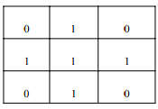
Kernel
A kernel is a (usually) small matrix of numbers that is used in image convolutions.
Differently sized kernels containing different patterns of numbers produce different results under convolution
The size of a kernel is arbitrary but 3x3 is often used
Example Kernel:

Slide 5
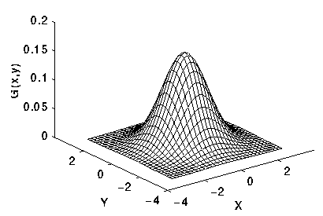

Gaussian Filter
In image processing, a Gaussian blur (also known as Gaussian smoothing) is the result of blurring an image by a Gaussian function. It is a widely used effect in graphics software, typically to reduce image noise and reduce detail. The idea of Gaussian smoothing is to use this 2-D distribution as a `point-spread' function, and this is achieved by convolution..
where σ is the standard deviation of the distribution.
Fig: 2-D Gaussian distribution with mean (0,0) and σ =1

Slide 6
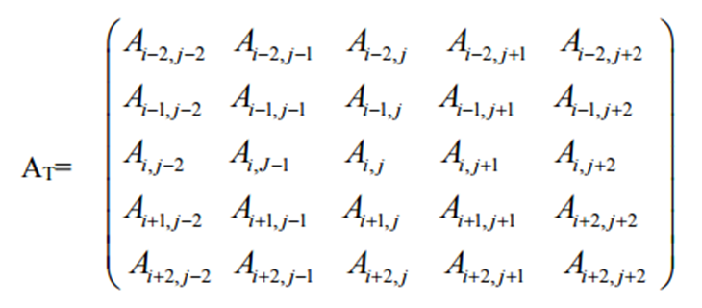
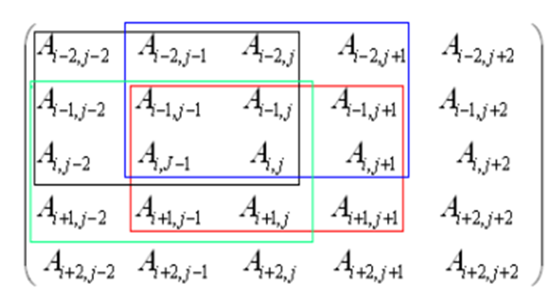
Gaussian Filter Algorithm
Consider a 5 x 5 test window AT from the noisy image as:
Divide this window into 3 x 3 sub-windows such that the test pixel should appear in each of the sub-windows. Nine such sub-windows are possible and four of them as shown below.

Slide 7
For each 3x3 sub-window calculate the standard deviation, σi, i=1, 2 ………N where N is maximum number of the sub-windows, for this paper it is equal to 9.
Set reference standard deviation, (σref), as median of σi, i=1, 2 ………N.
Set σmin = k1x σref.
Set σmax = k2 x σref.
Calculate average (σavg) of the standard deviations σi, i=1, 2 ………N whose standard deviation lies in the range [σmin, σmax].
This σavg is used as a parameter to decide whether the test pixel is corrupted or not.
The above process is repeated by sliding 5x5 window one step forward row wise and then column wise to cover the entire image.

Slide 8
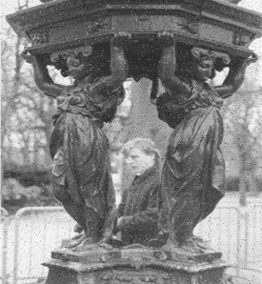

Noise image:
Removed noise:

Slide 9
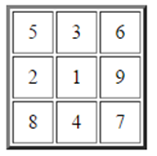
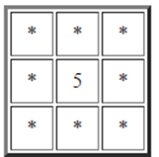
Mean Filter
The mean filter is a simple sliding-window spatial filter that replaces the center value in the window with the average (mean) of all the pixel values in the window. The window, or kernel, is usually square but can be any shape. An example of mean filtering of a single 3x3 window of values is shown below.
Unfiltered values
5 + 3 + 6 + 2 + 1 + 9 + 8 + 4 + 7 = 45 45 / 9 = 5
Mean Filtered

Slide 10
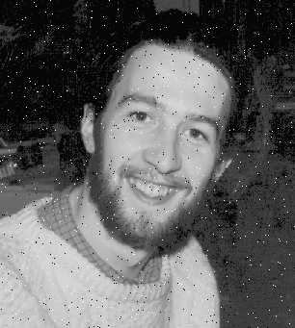
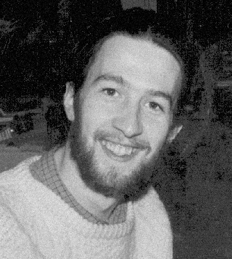
The idea of mean filtering is simply to replace each pixel value in an image with the mean ('average') value of its neighbors, including itself. This has the effect of eliminating pixel values which are unrepresentative of their surroundings. Mean filtering is usually thought of as a convolution filter
Noised image:
Removed noise:

Slide 11
CODE EXPLANATION

Slide 12
Thank you

